Slide 1
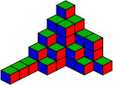
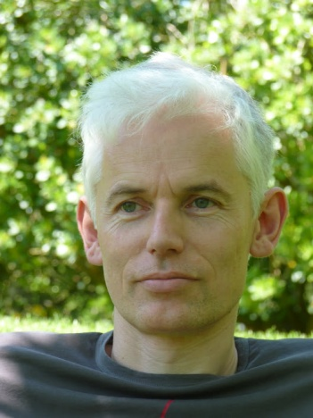
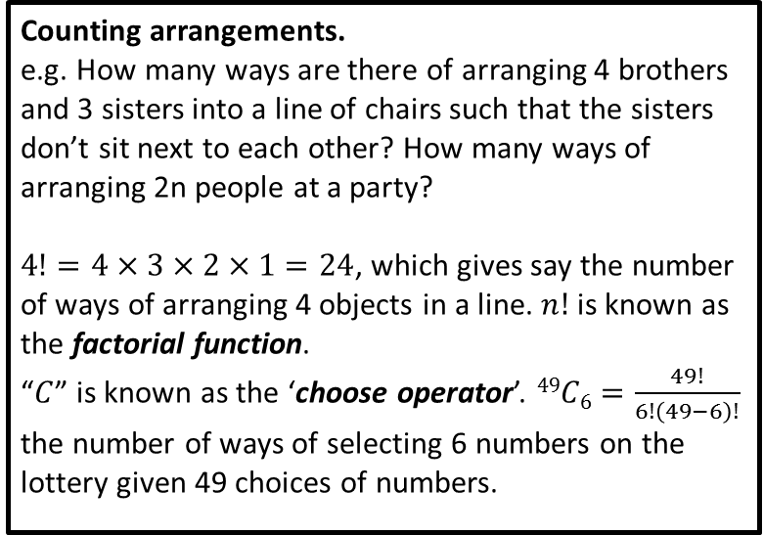
Combinatorics
Counting arrangements.
e.g. How many ways are there of arranging 4 brothers and 3 sisters into a line of chairs such that the sisters don’t sit next to each other? How many ways of arranging 2n people at a party?
$4!=4×3×2×1=24$, which gives say the number of ways of arranging 4 objects in a line. $n!$ is known as the factorial function.
“$C$” is known as the ‘choose operator’. $49C6=\frac{49!}{6!\left(49−6\right)!}$ the number of ways of selecting 6 numbers on the lottery given 49 choices of numbers.
Timothy Gowers (1963-)
Awarded a Fields medal in 1998 for his works on Banach Spaces, which combines combinatorics with functional analysis.

Slide 2
2xy² – 3x = 4
Algebra
Algebra is the study of operations (e.g. +, x) and their application in solving equations. It typically uses ‘variables’ to represent objects.
It might involve solving a simple linear equation such as 4x + 1 = 5, or a quadratic equation like x² + 2x - 3 = 0, or solving multiple ‘simultaneous’ equations at once, e.g. “x + y = 5 and 2x – 3y = 4”.
Elementary Algebra is what you’re most conventionally used to at school. Linear Algebra involves the study of linear equations, vector spaces and matrices. Boolean Algebra involves ‘logic’, and values can only be ‘true’ or ‘false’ instead of numbers!

Slide 3
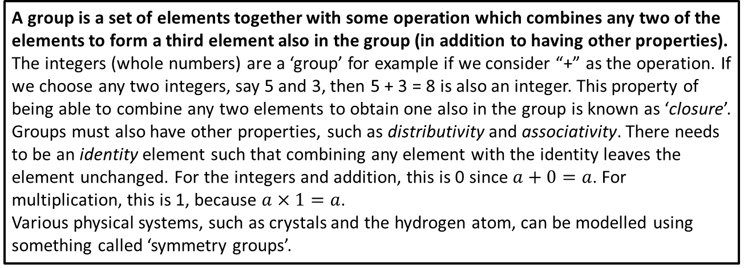
Group Theory
A group is a set of elements together with some operation which combines any two of the elements to form a third element also in the group (in addition to having other properties).
The integers (whole numbers) are a ‘group’ for example if we consider “+” as the operation. If we choose any two integers, say 5 and 3, then 5 + 3 = 8 is also an integer. This property of being able to combine any two elements to obtain one also in the group is known as ‘closure’. Groups must also have other properties, such as distributivity and associativity. There needs to be an identity element such that combining any element with the identity leaves the element unchanged. For the integers and addition, this is 0 since $a+0=a$. For multiplication, this is 1, because $a×1=a$.
Various physical systems, such as crystals and the hydrogen atom, can be modelled using something called ‘symmetry groups’.

Slide 4
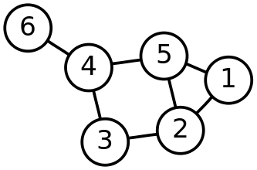
Graph Theory
A graph is a series of nodes (dots) connected by edges (lines).
Whenever you use a journey planner/GPS to find a route, its finds the shortest path through one of these ‘graphs’, using an algorithm such as Dijskstra’s Algorithm or an “A* algorithm”.
One famous problem in Graph Theory is the Four Colour Theorem. It asks whether we can colour the nodes of the graph using just 4 colours, such that no two adjacent nodes connected with an edge share the same colour. A Eulerian Circuit is a route through a graph which visits every edge exactly once and ends up at the starting location. Have a look at the “Seven Bridges of Konigsberg” problem which relates to this.

Slide 5
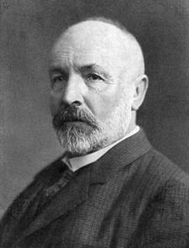
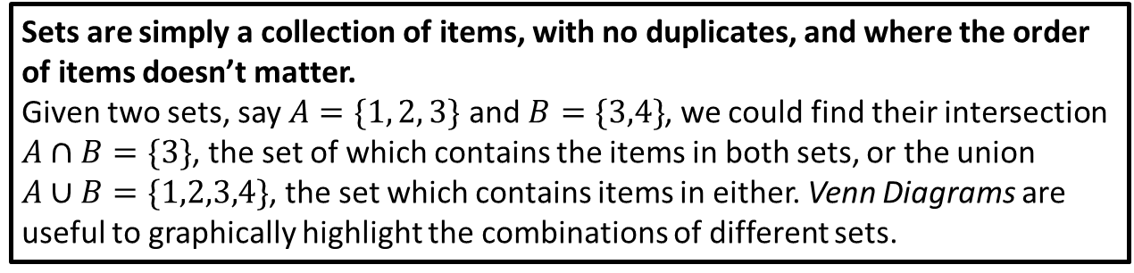
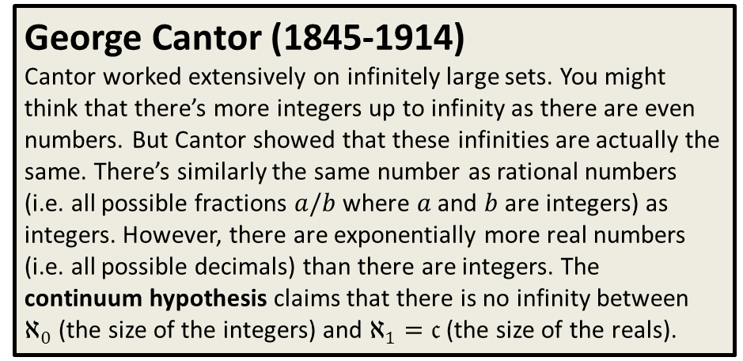
Set Theory
Sets are simply a collection of items, with no duplicates, and where the order of items doesn’t matter.
Given two sets, say $A=\{1, 2, 3\}$ and $B=\{3,4\}$, we could find their intersection $A∩B=\{3\}$, the set of which contains the items in both sets, or the union $A∪B=\{1,2,3,4\}$, the set which contains items in either. Venn Diagrams are useful to graphically highlight the combinations of different sets.
George Cantor (1845-1914)
Cantor worked extensively on infinitely large sets. You might think that there’s more integers up to infinity as there are even numbers. But Cantor showed that these infinities are actually the same. There’s similarly the same number as rational numbers (i.e. all possible fractions $a/b$ where $a$ and $b$ are integers) as integers. However, there are exponentially more real numbers (i.e. all possible decimals) than there are integers. The continuum hypothesis claims that there is no infinity between $ℵ_{0}$ (the size of the integers) and $ℵ_{1}=𝔠$ (the size of the reals).

Slide 6
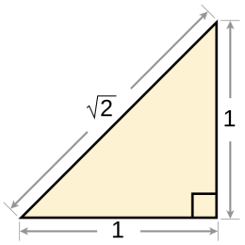
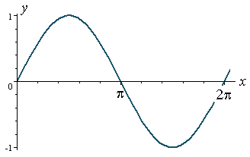
Geometry
Deals with shape, size, relative positioning of objects and properties of space.
This includes for example Pythagoras’ Theorem (the relationship between the side lengths of a right-angled triangle), constructions (is it possible to draw an equilateral triangle using just a compass – what about a regular pentagon?), calculating volumes and areas of shapes, and symmetry.
Trigonometry
Deals with triangles, studying the relation between the sides and the angles between these sides.
The main trigonometric functions are sin, cos and tan.

Slide 7
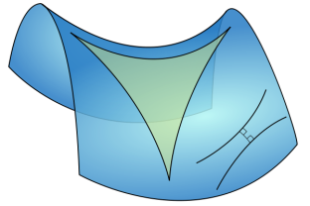
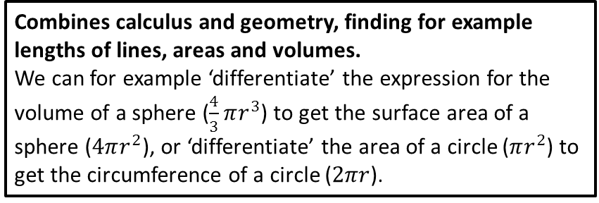
Differential Geometry
Combines calculus and geometry, finding for example lengths of lines, areas and volumes.
We can for example ‘differentiate’ the expression for the volume of a sphere ($\frac{4}{3}πr^{3}$) to get the surface area of a sphere ($4πr^{2}$), or ‘differentiate’ the area of a circle ($πr^{2}$) to get the circumference of a circle ($2πr$).

Slide 8

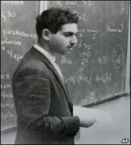
Topology
Topology concerns properties of space, namely
connectedness, continuity and boundary.
Consider for example the Möbius Strip pictured above. It only has one face, and you’re only restricted in movement in one direction (i.e. across the width of the strip). When on the surface of a sphere (e.g. the Earth) there’s again one face, but no boundary restrictions.
Grigori Perelman (1966-)
Solved the Poincaré Conjecture, a well-known problem in topology for which there was a $1 million prize attached. He famously turned down the prize, along with a Fields Medal.
The problems states that “Every simply connected, closed 3-manifold is homeomorphic to the 3-sphere.”

Slide 9

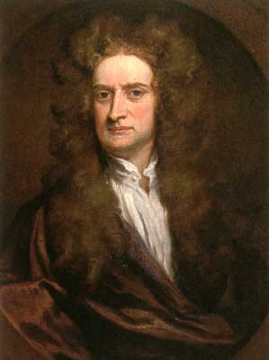
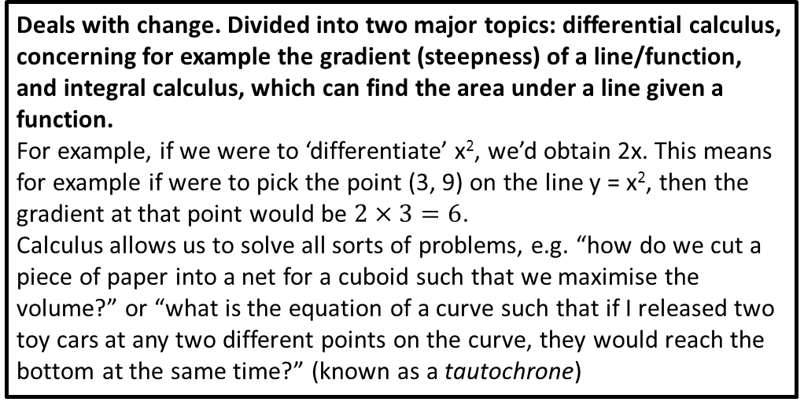
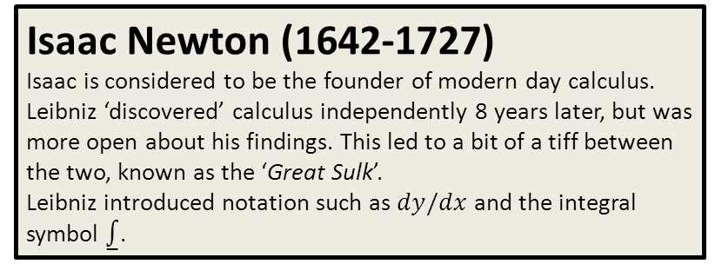
Calculus
Deals with change. Divided into two major topics: differential calculus, concerning for example the gradient (steepness) of a line/function, and integral calculus, which can find the area under a line given a function.
For example, if we were to ‘differentiate’ x², we’d obtain 2x. This means for example if were to pick the point (3, 9) on the line y = x², then the gradient at that point would be $2×3=6$.
Calculus allows us to solve all sorts of problems, e.g. “how do we cut a piece of paper into a net for a cuboid such that we maximise the volume?” or “what is the equation of a curve such that if I released two toy cars at any two different points on the curve, they would reach the bottom at the same time?” (known as a tautochrone)
Isaac Newton (1642-1727)
Isaac is considered to be the founder of modern day calculus. Leibniz ‘discovered’ calculus independently 8 years later, but was more open about his findings. This led to a bit of a tiff between the two, known as the ‘Great Sulk’.
Leibniz introduced notation such as $dy/dx$ and the integral symbol ⨜.

Slide 10
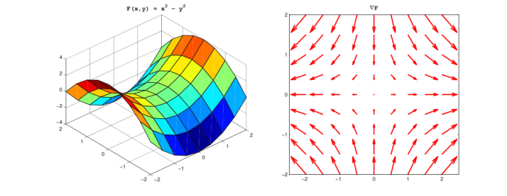
Vector Calculus
Concerns differentiation and integration of vectors, usually in 3D space.
For example, we could find the gradient of a surface (rather than just of a line), yielding a vector which points in the direction of greatest increase at that point on the surface. The Laplace operator finds the second-order derivative when similarly involving multiple variables/dimensions.

Slide 11

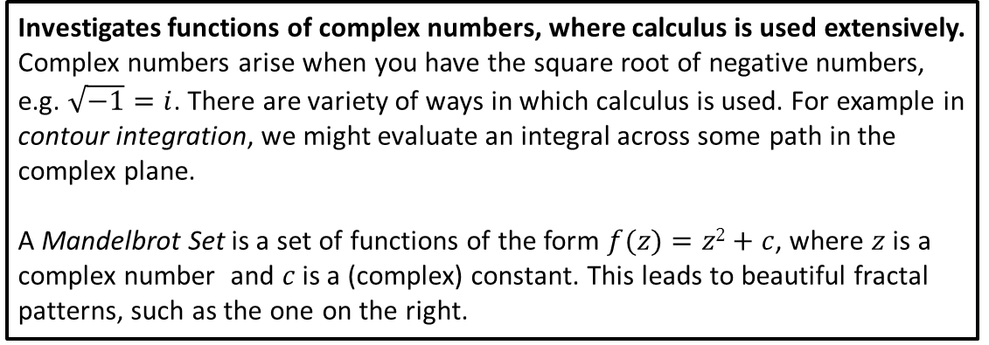
Complex Analysis
Investigates functions of complex numbers, where calculus is used extensively.
Complex numbers arise when you have the square root of negative numbers, e.g. $\sqrt{−1}=i$. There are variety of ways in which calculus is used. For example in contour integration, we might evaluate an integral across some path in the complex plane.
A Mandelbrot Set is a set of functions of the form $f(z)=z2+c$, where $z$ is a complex number and $c$ is a (complex) constant. This leads to beautiful fractal patterns, such as the one on the right.

Slide 12
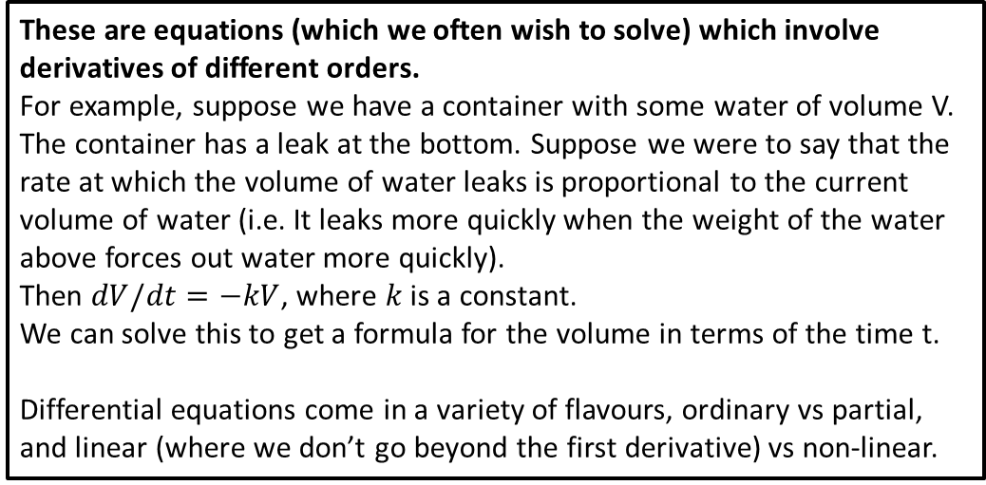
Differential Equations
These are equations (which we often wish to solve) which involve derivatives of different orders.
For example, suppose we have a container with some water of volume V. The container has a leak at the bottom. Suppose we were to say that the rate at which the volume of water leaks is proportional to the current volume of water (i.e. It leaks more quickly when the weight of the water above forces out water more quickly).
Then $dV/dt=−kV$, where $k$ is a constant.
We can solve this to get a formula for the volume in terms of the time t.
Differential equations come in a variety of flavours, ordinary vs partial, and linear (where we don’t go beyond the first derivative) vs non-linear.

Slide 13

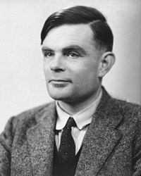
Cryptography
Cryptography is the process of ciphering (and deciphering) sensitive data.
During WWII, Alan Turing invented a machine that could find settings for the ‘Enigma Machine’ in order to decode German transmissions. Most secure systems nowadays use RSA encryption. This is a commonly used encryption method that exploits the fact for a number that is the product of two large primes, there is no known method to quickly find what these two primes were. RSA uses a number of key concepts and functions from Number Theory, such as Fermat’s Little Theorem, Euler’s Totient Function, Euler’s Theorem and modular arithmetic.
Alan Turing(1912-54)

Slide 14
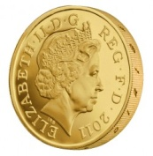
Probability
A measure of how likely something is to happen.
There’s a number of interesting problems here:
Gambler’s Ruin: If two players each have some number of coins (potentially different quantities) and you keep flipping a coin such that the winner each time takes one of the other player’s coins, what’s the probability that a particular player wins?
Buffoon’s Needle: You flip a needle of length L onto a sheet of paper with horizontal lines across it a distance of H apart. What’s the probability that the needle doesn’t cross a line?
The Hypergeometric Distribution: What’s the probability of getting 0 matching numbers on the National Lottery? What about 1 number? 2? 3? 4? 5? All 6? These probabilities form a hypergeometric distribution.

Slide 15
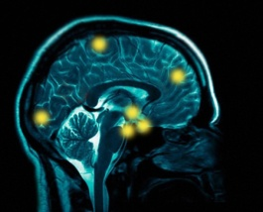
Mathematical Biology
Modelling biological systems using mathematics.
This might include for example modelling the human heart, or neurons in the brain, the mechanics of biological tissues, cancer simulation, using algebra in DNA sequencing methods, enzyme kinetics, etc.

Slide 16
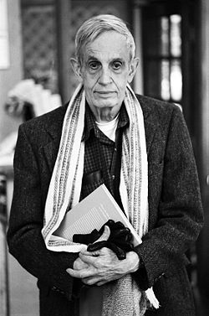
Mathematical Economics
The application of mathematical methods to analyse problems in economics.
This might include:
Optimisation problems: Given a model (say a business model) with certain parameters we can set, and a certain goal, how can we maximise the gain?
Static/equilibrium analysis of a market or economic system.
Dynamic Analysis: Tracing changes in an economic system over time.
John Nash Jr (1928-)
Nash, while an accomplished mathematician with contributions in differential geometry and partial differential equations, is most known for his work in Game Theory, a branch of mathematics which concerns modelling the conflict and cooperation of different people/organisations based on reward and risk.
He won the Nobel Prize in Economics for the theory of ‘Nash Equilibrium’, concerning the solution of a non-cooperative ‘game’ involving two or more players.
The film ‘A Beautiful Mind’, in which Russell Crowe plays John Nash, highlights both his genius and his struggles with schizophrenia.

Slide 17
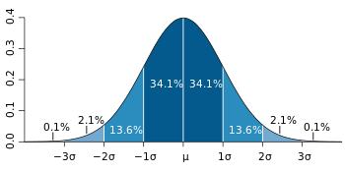
Statistics
Statistics is the collection, organisation, analysis, interpretation and presentation of data.
On a simple level, this might involve working out a mean of a sample or producing a pie chart. Somewhat more complicated are things like regression, where we adjust parameters of a model to best fit the data (e.g. when drawing a line of best fit on a scatter diagram, we’re implicitly working out the gradient and y-intercept of a line which best matches the data!).
Hypothesis testing is when we try to work out how likely it is something happened by chance. For example, to declare something as a ‘scientific discovery’, we generally need a “5 sigma” certainty, that is, there would be about a 1 in 2 million chance of the evidence occurring by chance were our discovery/model actually false.

